Slide 1

The Potentiometer
University physics lab center of UESTC

Slide 2
outline
content
1 aim (Theoretical and experimental integration, experimental skills and testing methods, innovative experimental content)
2 principle (The theory and background of the experiment to be verified, and the ideas and methods of experimental design)
3 content(Experimental test points, experimental steps, data processing, experimental notes)
4 exercise(Innovative design, expand the experimental test content)

Slide 3
aim
1 aim
Grasp the working principle of the potential difference meter and structural characteristics
Understand the thermocouple temperature measurement principle

Slide 4
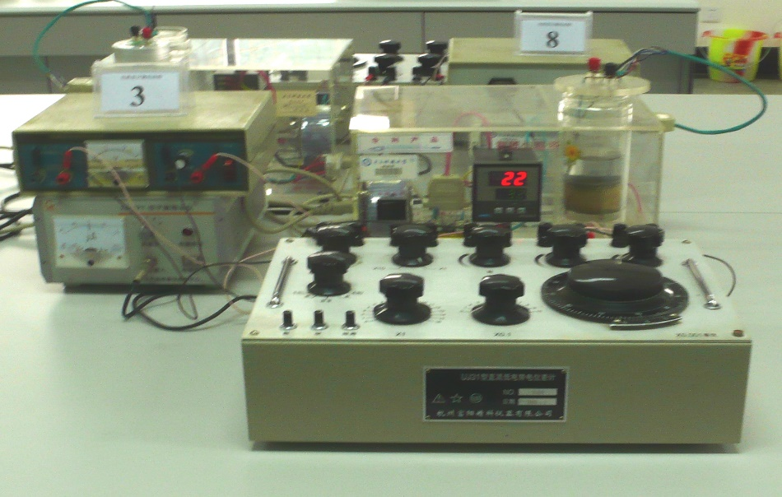
Potentiometer is a precision measurement of the potential difference or voltage of the instrument
Its principle is to use a known voltage and unknown voltage compensation is measured, mainly used to measure the electromotive force, the potential difference and calibration meter, can also be used to indirectly measure the resistance , Current and some non-power (such as temperature, pressure)
The accuracy of up to 0.1% to 0.03%.

Slide 5
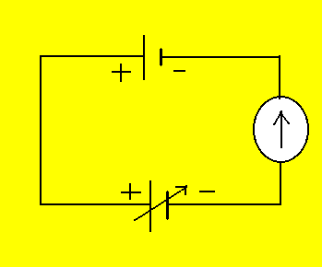
principle
2 principle for the expriment
2.1 Compensation principle
E_{x}
G
E₀
Schematic diagram
As shown above, adjust E₀， When the sensitive ammeter refers to zero E_{x}=E₀。
This use of known electromotive force to offset the measured electromotive force method known as the compensation method 。

Slide 6
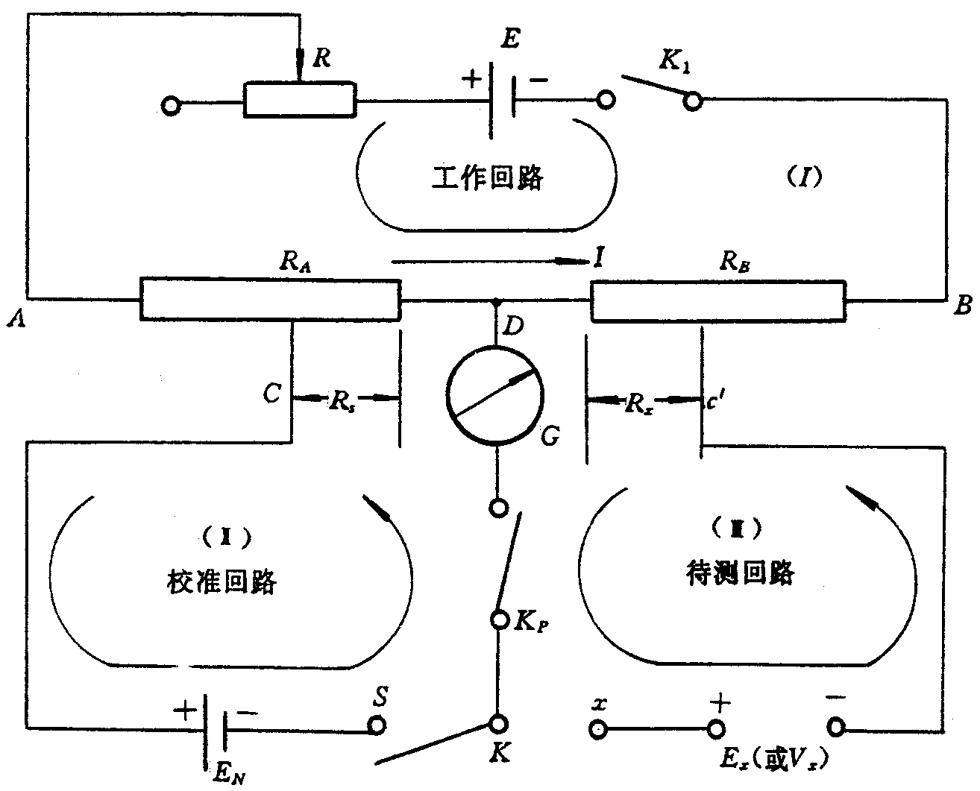
principle
2.2 The working principle of potential difference meter

Slide 7
实验原理
Working circuit
The current in the loop is 10.00mA, through the Rx generated to compensate Ex for the working voltage E₀
(2) Calibration circuit
Used to calibrate the working current of circuit, from the standard power calibration, set Rs, and then by adjusting the work of the R to calibrate the operating current.
(3) Circuit under measurement
The circuit under test is the compensation circuit, the balance is :the measured voltage E_{x} equal to the voltage between two sides of R_{x}
E_{x} = I R_{x} for，I=10.00mA.

Slide 8
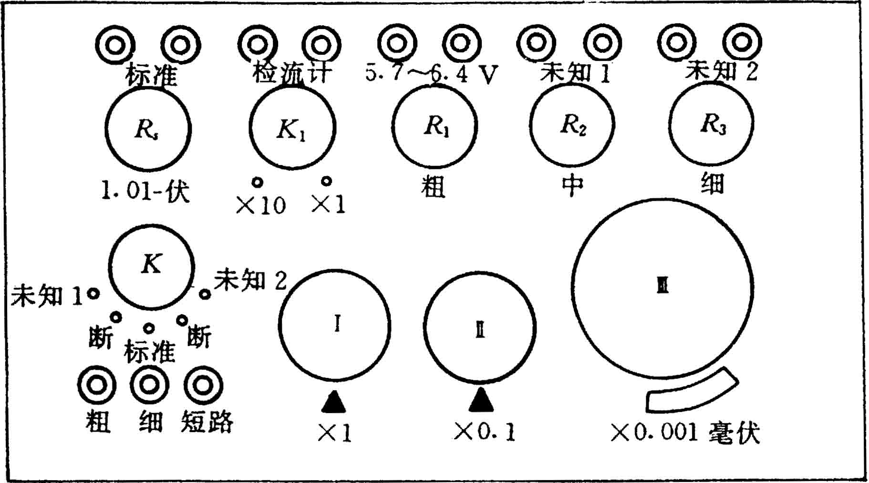
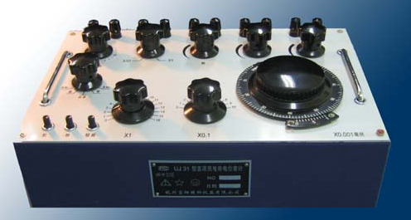
principle
Schematic and panel map corresponding relationship

Slide 9
principle
2.3 Thermocouple
The two different metals connected into a closed loop, and let the two nodes at different temperatures T and T0 in the heat source, the current in the circuit flows, this current is called the temperature current,
The current EMF is called Thermo-electromotive force. Can be approximated as E = θT + E0 (where θ and E0 are constants to be determined)
Constantan(60%Cu,40Ni)
water
copper(Cu)

Slide 10
content
3 content
(1) Experimental content
Adjust of the potentiometer
Measure the Thermo - electromotive Force of Thermocouple (Copper - Constantan)

Slide 11


content
(3) Data and procedure
materies room temperature Magnification
 | 35 | 40 | 45 | 50 | 55 | 60
 | 65 | 70 | 75 | 80 | 85 | ——
 |  |  |  |  |  | ——

